Slide 1
Style Transfer for Headshot Portraits
Team Name: A3D
Mentor TA: Manasvi Vaidyula
Adhiraj Deshmukh - 2021121012 - CSD
Aparna Agarwal - 2021121007 - CSD
Anjali Singh - 2020102004 - ECE
Deepthi Chandak - 2020102013 - ECE
Repo URL: a3d-link

Slide 2
Index
Objective
Motivation
Understanding of the Paper
Approach
Outputs
Limitations/Failures
Conclusion
Dataset
Contributions

Slide 3
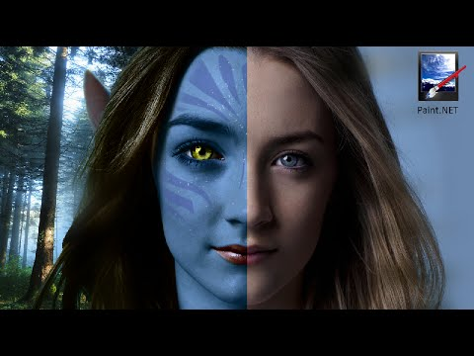
Objective
The main objective of our project is to transfer the visual style of the example portrait made by an artist onto another image, which basically means to match the appearance of the input subject to the example.

Slide 4
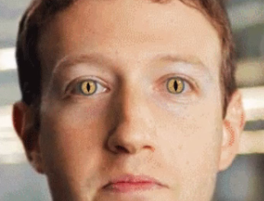
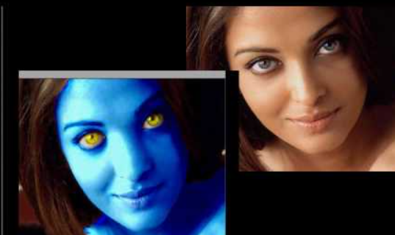
Motivation
The editing process to create different renditions of headshot photos to achieve a compelling style requires advanced skills because features such as the eyes, the eyebrows, the skin, the mouth and the hair, all require specific treatments.
The tolerance for errors is low, and one bad adjustment can quickly turn a great headshot into an uncanny image. Many compelling looks require maintaining a visually pleasing appearance while applying extreme adjustments.

Slide 5
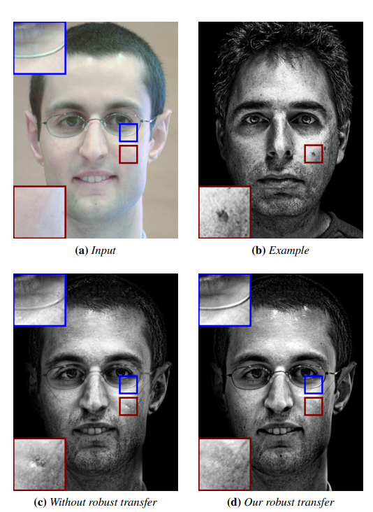
Understanding of the Paper
The paper uses a multiscale technique to robustly transfer the local statistics of an example portrait onto a new one. This technique matches properties such as the local contrast and the overall lighting direction while being tolerant to the unavoidable differences between the faces of two different people.
All the facial features are treated differently on the basis of characteristics like lighting etc., this challenge is overcome by an approach specific to faces.
Our Notes :https://github.com/Digital-Image-Processing-IIITH/dip-m22-project-a3d/blob/main/docs/Paper_Notes.pdf

Slide 6
Approach
Align input and example faces using a 3-step process
multiscale approach to transfer local statistics of example onto input
Transferring the eye highlights and matching the example background
Helps in getting the critical style characteristics like skin texture, hair rendition etc.

Slide 7
Dense Correspondence Approach
Detect facial landmarks of both input and Example image.
(68 landmark points)
Perform the subdivisions of the regions based on Delaunay conditions
(Delaunay triangulation)
Affine Transform each of this triangle of Example image to corresponding Input image triangular region
Refine correspondence using SIFT flow
(not implemented)
Morph example to the input using segments on face templates
(wraps and alpha blend triangular region)

Slide 8
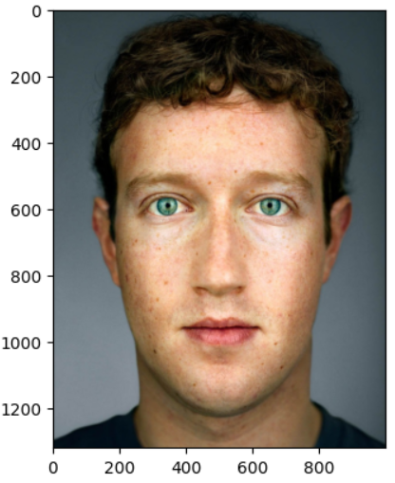
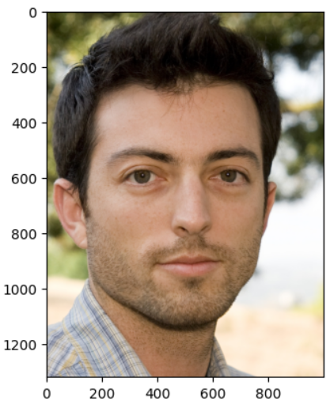
Example Image
Input Image

Slide 9
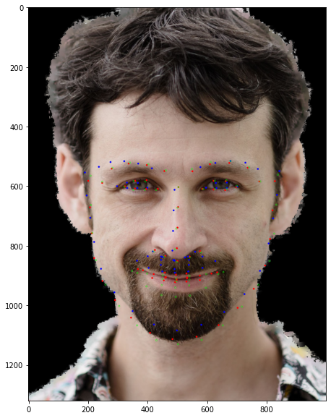
Comparison of 3 different techniques of landmark detection
Blue landmarks -> dataset landmarks
Green landmarks -> OpenCV
Red landmarks -> Dilib

Slide 10
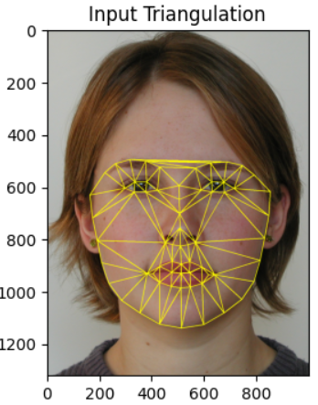
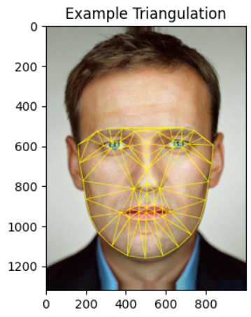
Triangulation Outputs
Below are the Delaunay triangulation outputs we got

Slide 11
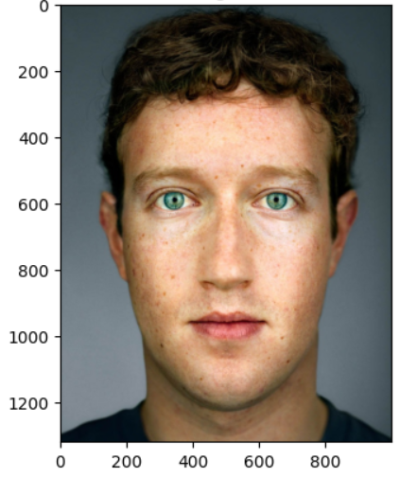
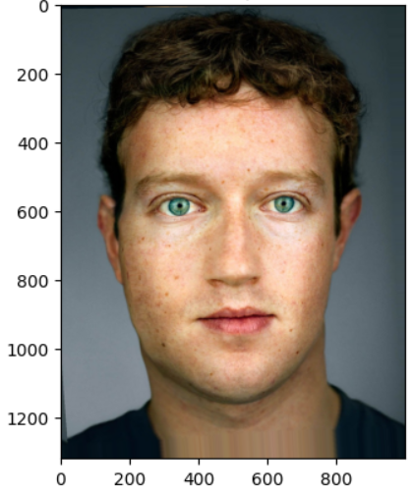
Warped Outputs
Original
Warped

Slide 12
Multiscale Approach
Multiscale Decomposition
Local Energy
Robust Transfer
Decompose input and example images into multiscale Laplacian stacks, using a 2D Gaussian Kernel
Estimating local energy, S in each subband, by local average of square of subband coefficients, using a warping operator
modify the input subbands so that they get the same energy distribution as the example subbands

Slide 13
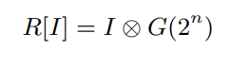
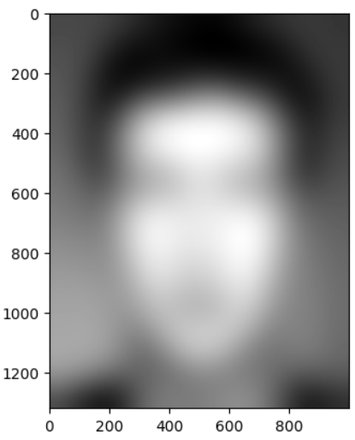
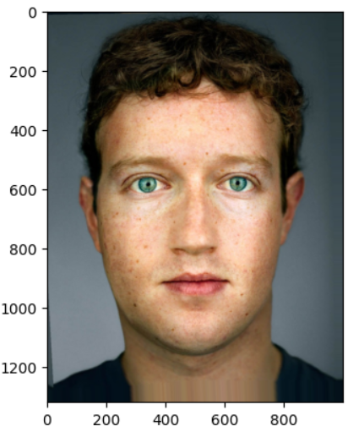
Residual Image Output
Warped Image Output
with n levels

Slide 14
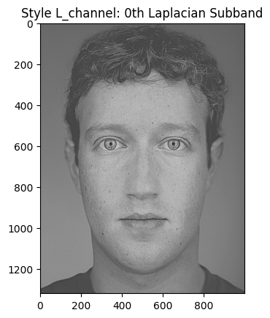
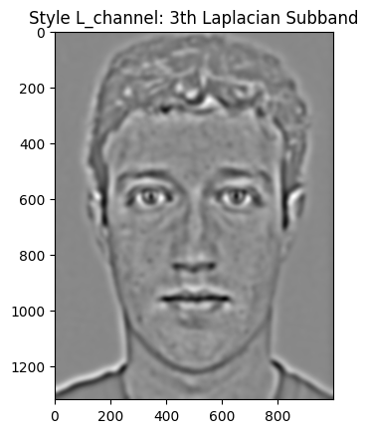
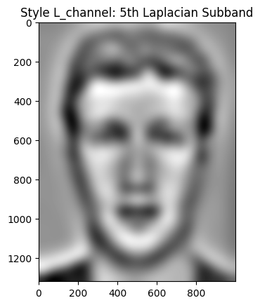
Multiscale Laplacian Stacks

Slide 15
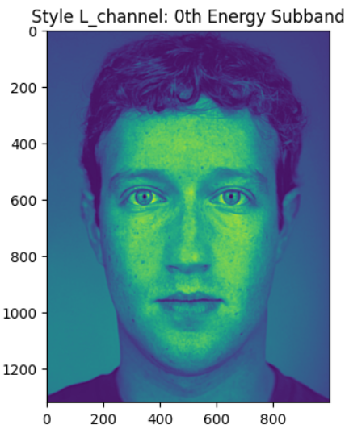
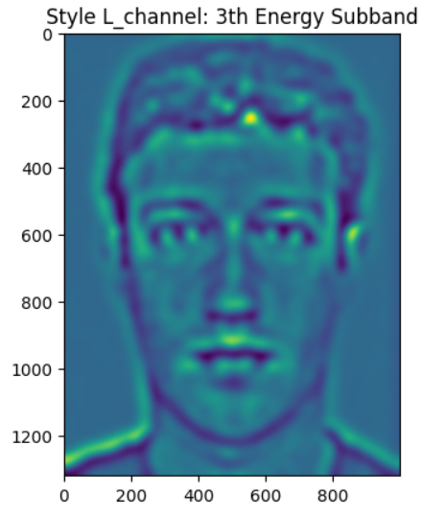
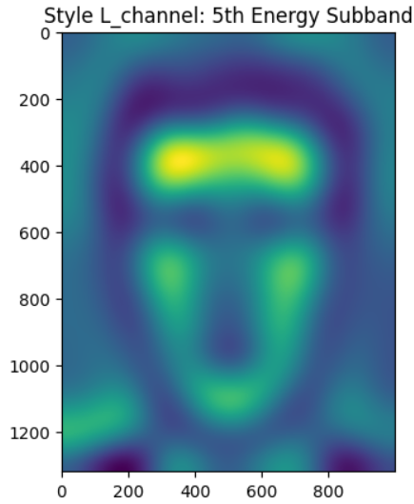
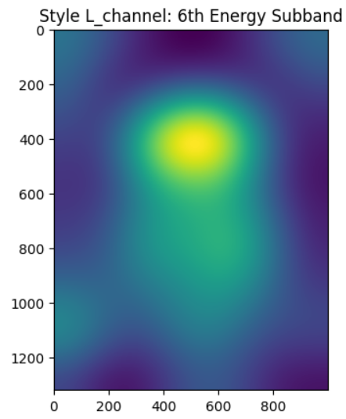
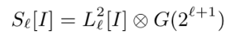
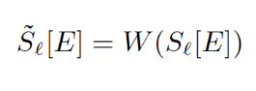
Energy Maps
Computing local energy for both images using the given equation, which allows to capture the frequency profiles in the images. These energy maps get the strengths in lighting and color
Local Energy Subbands

Slide 16
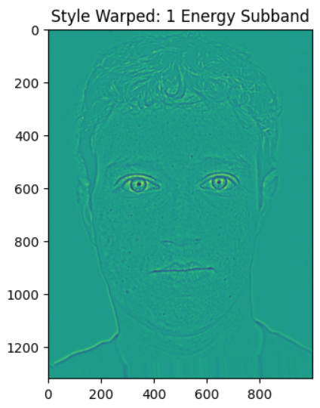
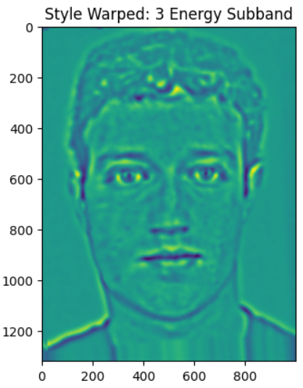
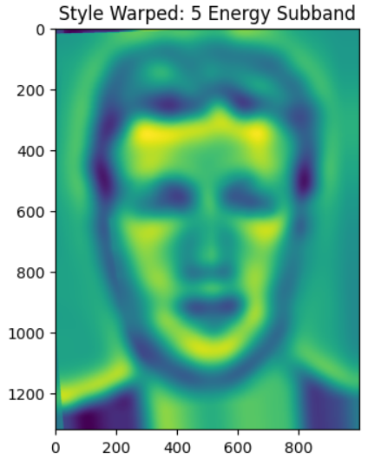
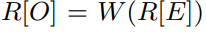
Warped Style Local Energy Subband
Warping operator
It gives Warped example residual

Slide 17
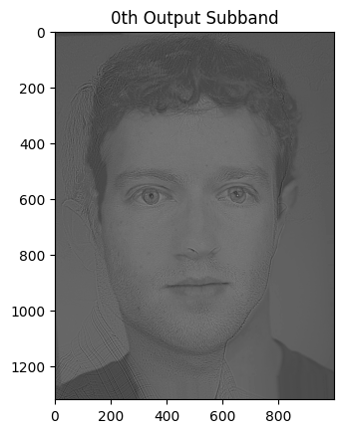
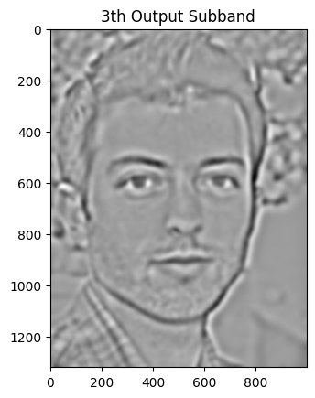
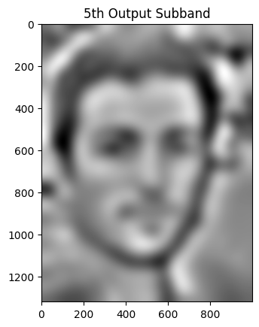
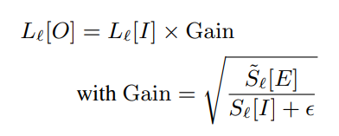
Robust Transfer
we modify the input subbands so that they get the same energy distribution as the example subband

Slide 18
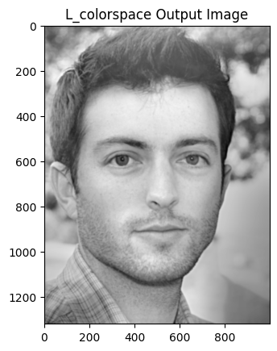
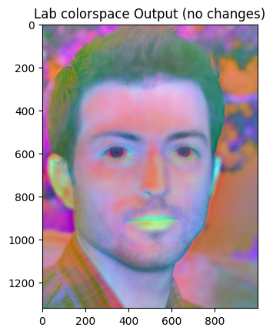
Aggregate Outputs

Slide 19
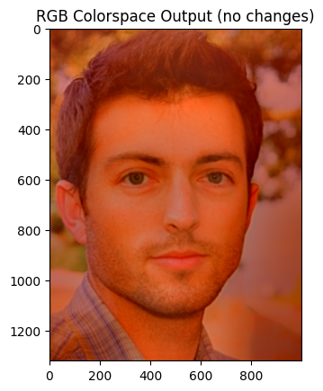
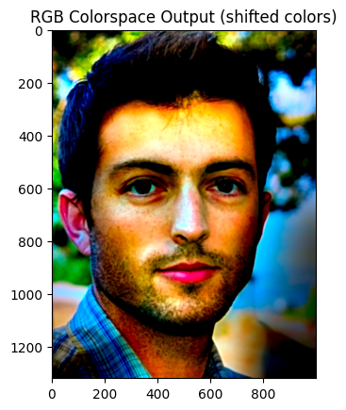
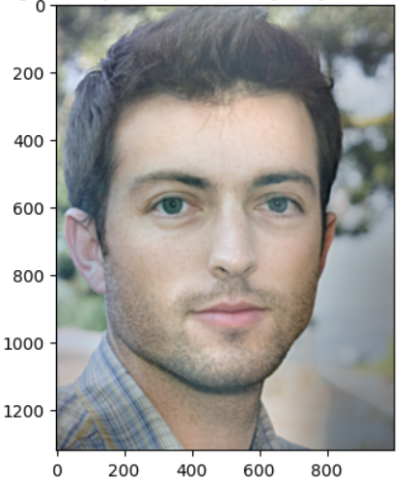
Output when algorithm is performed strictly on just RGB colorspace instead of LAB

Slide 20
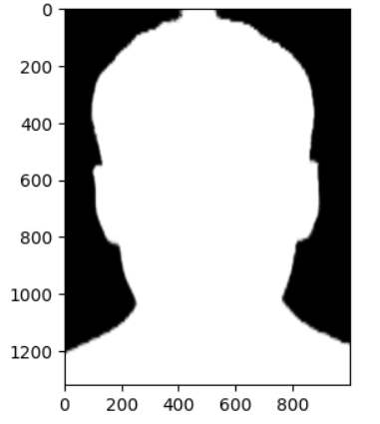
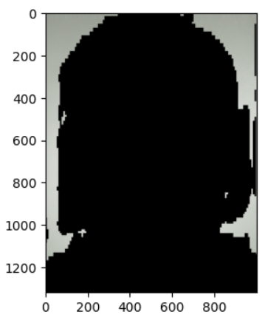
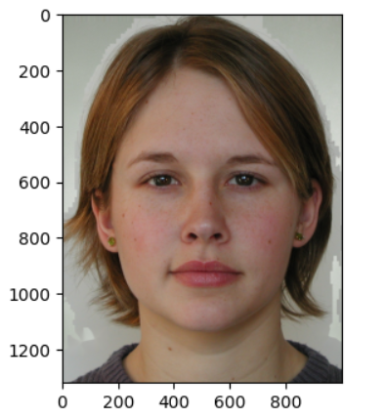
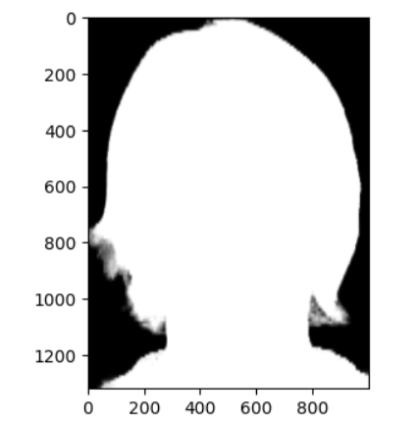
Post Processing
Example Image
Background - Replacing input background with example background
Get masks get background replace background get imperfection mask image implanting
Input Image

Slide 21
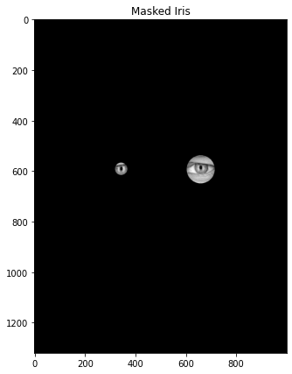
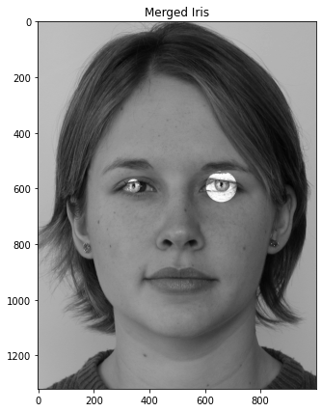
Post Processing
Eye Highlights (couldn’t implement it fully) - Separating the specular reflection from the example eyeball and copy that onto input’s eyes. This involved: -
iris location using circular arc detection running a k-means algorithm for segmentation of iris, pupil and highlights refining the reflection mask using alpha matting.
This is what we were able to achieve

Slide 22
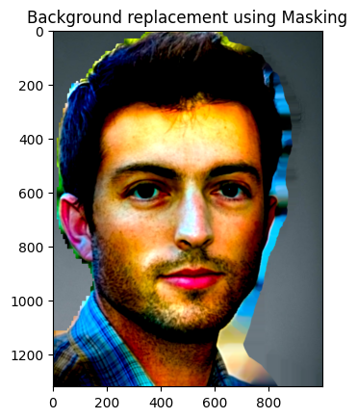
Input
Example
Output
Final

Slide 23
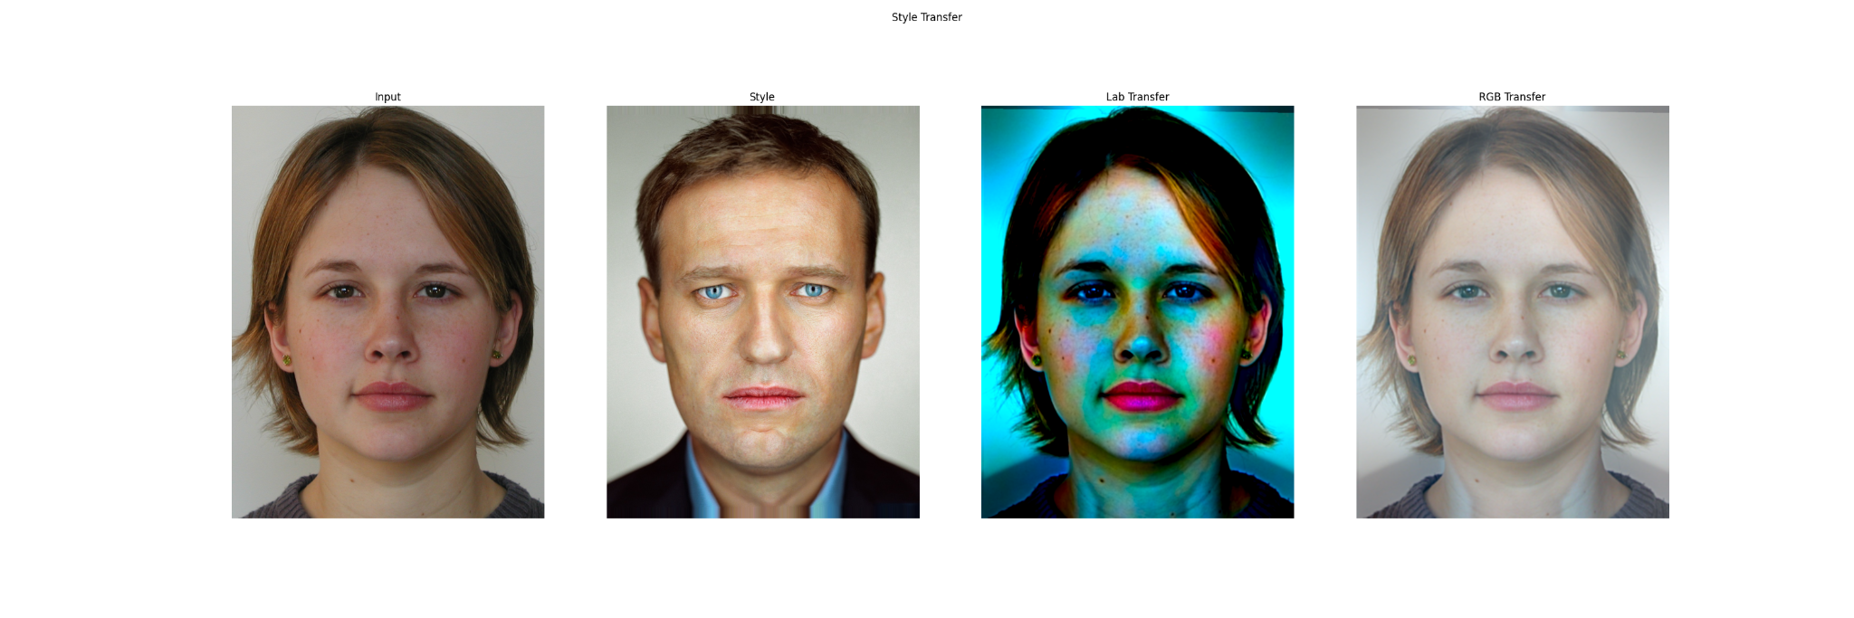
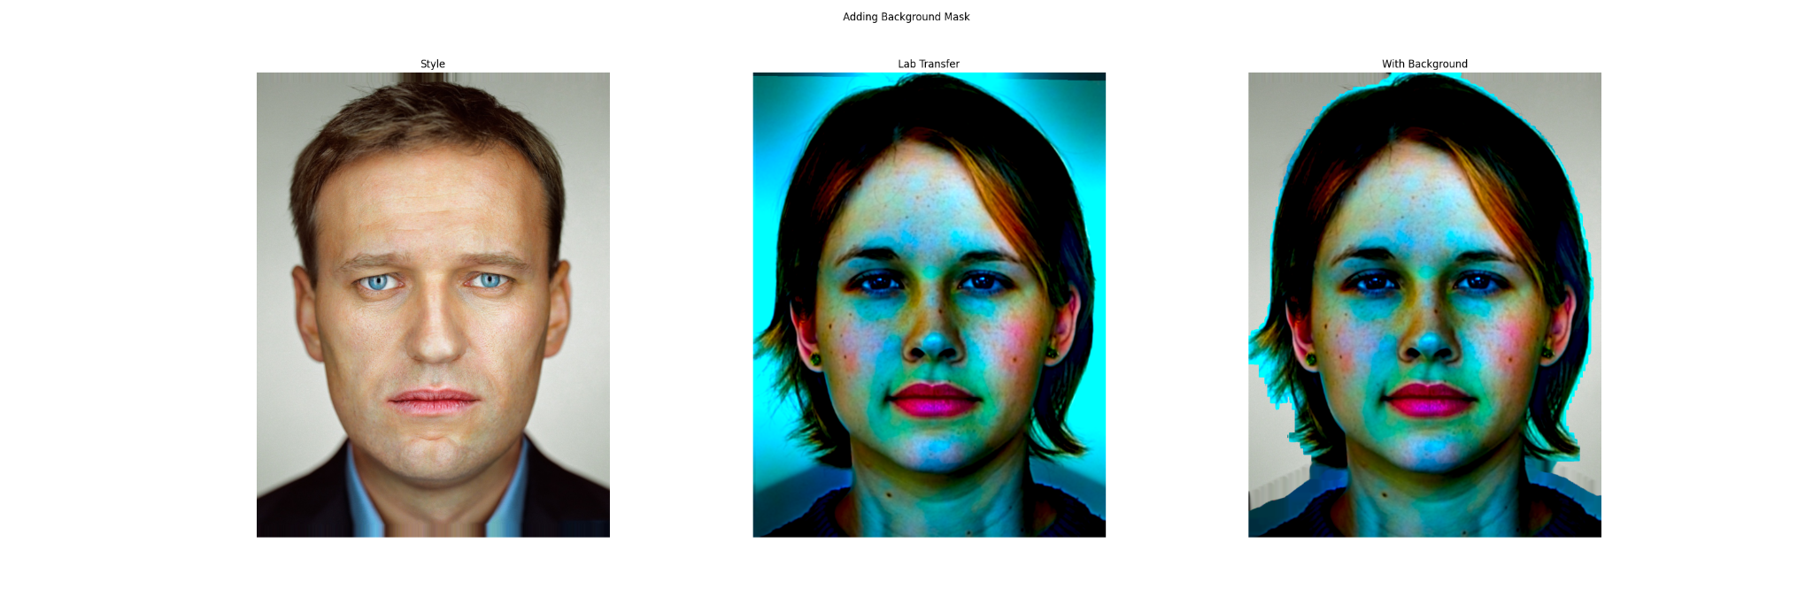

Slide 24
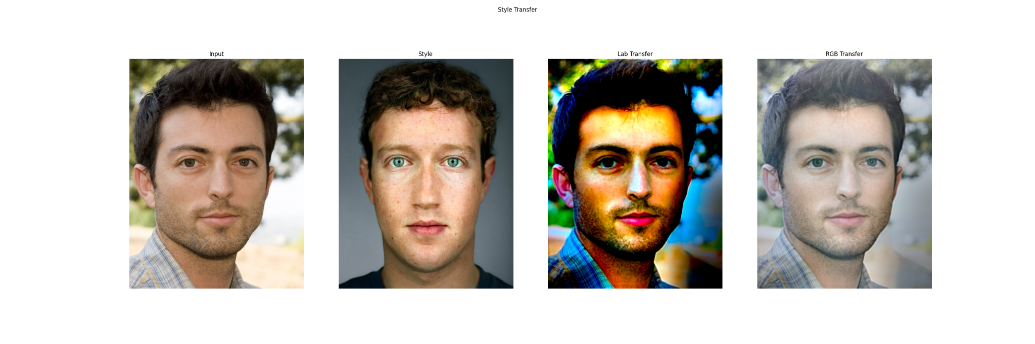
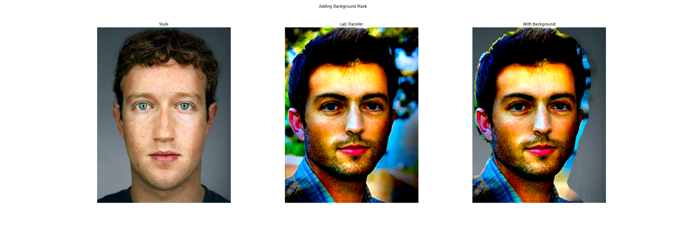

Slide 25
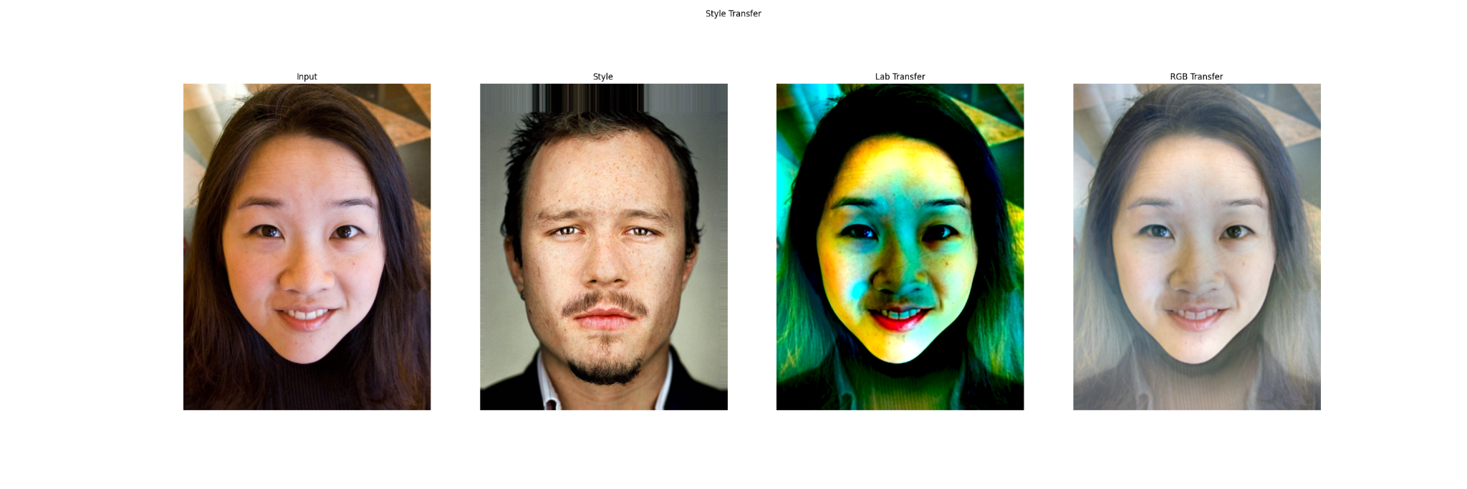
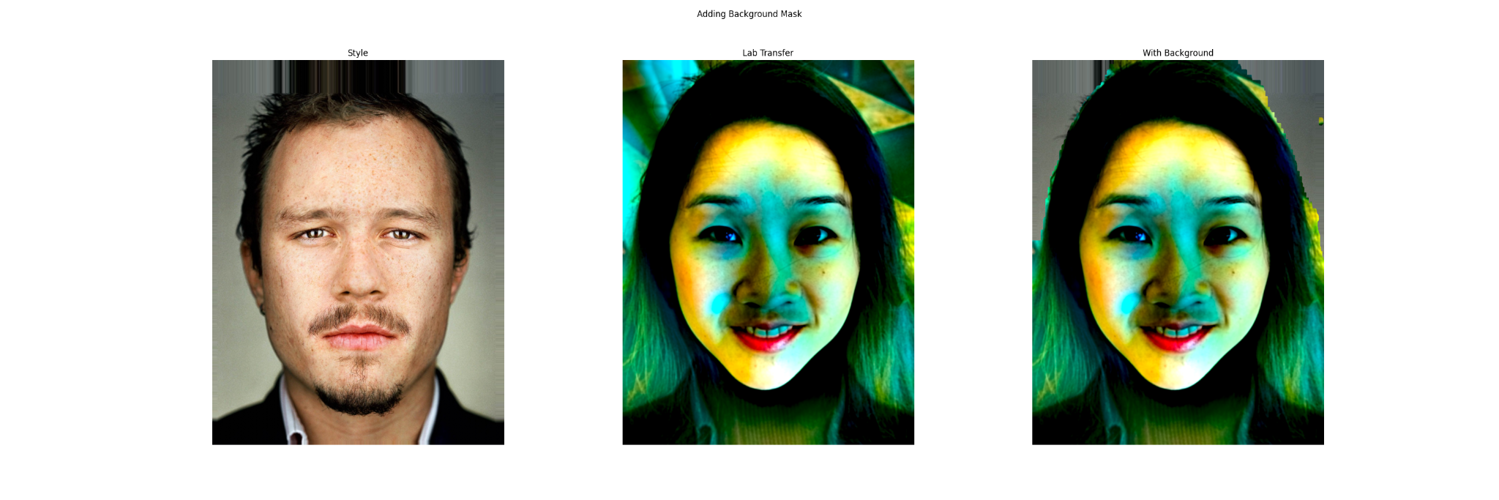

Slide 26
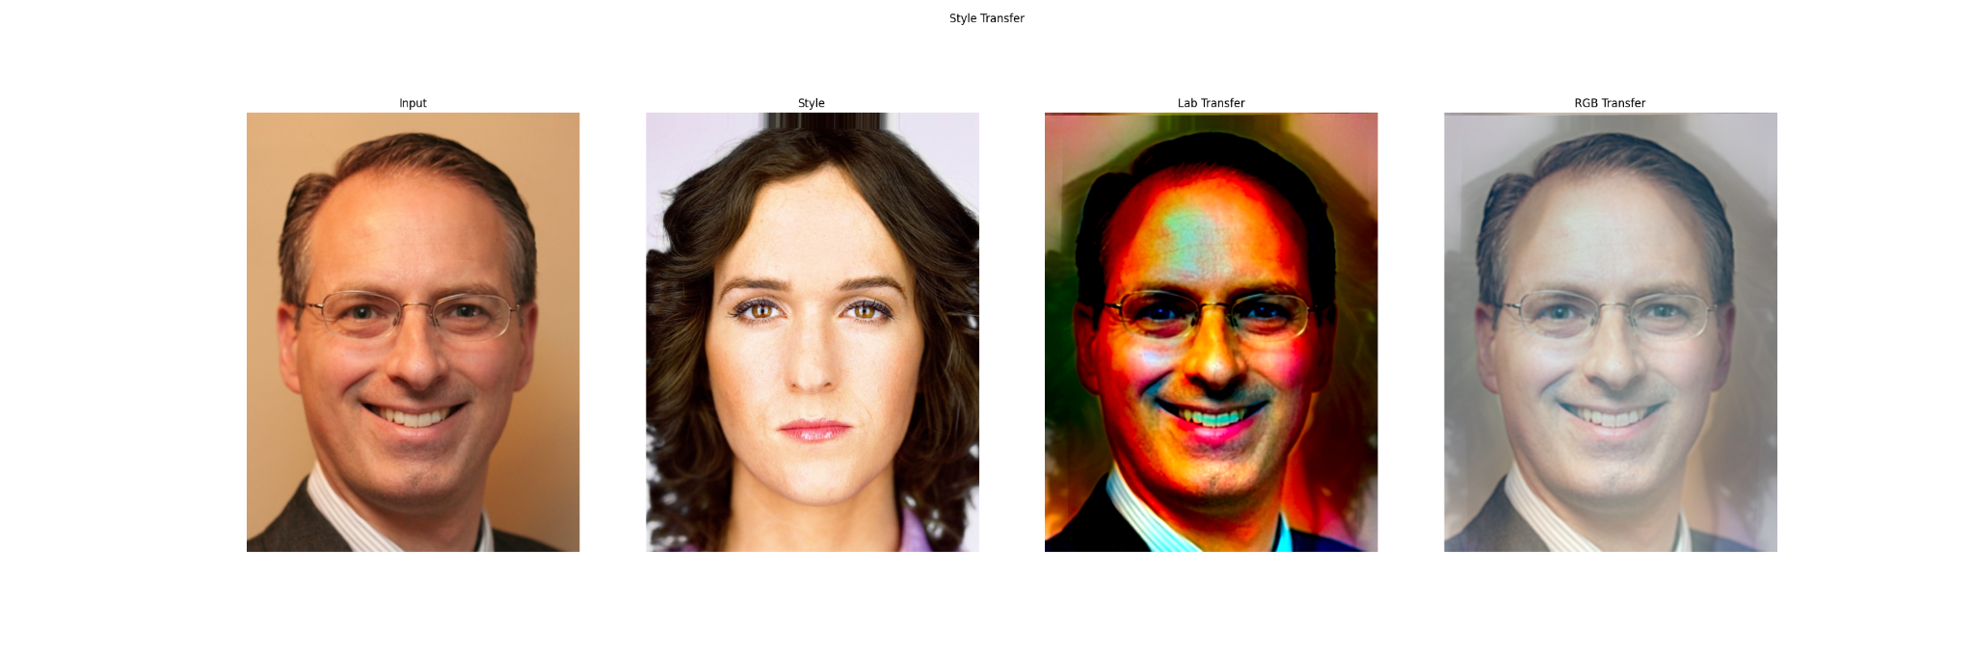


Slide 27



Slide 28



Slide 29
Limitations
Results of style transfer are affected since conversion from LAB to RGB colorspace is not done properly, but using the algorithm in RGB colorspace strictly gives us surprisingly good results
Not able to get the complete background transfer from example to input when there is low contrast.
Not able to eliminate hair features from style images properly
Doesn’t work properly when huge difference in skin colors
Low lighting doesn’t low style features to get eliminated easily

Slide 30
Contributions
Adhiraj Deshmukh - Paper readings, dense correspondence, energy maps (multiscale transfer), combining all outputs
Aparna Agarwal - Paper readings, laplacian stacks; energy maps (multiscale transfer), background (post processing)
Anjali Singh - Paper Readings, multiscale decomposition (multiscale transfer), background; Eye highlights (Post processing), ppt work
Deepthi Chandak - Paper readings, eye highlights, ppt work

Slide 31
Dataset
Link to the dataset: click here to download

Slide 32
Thank You :)

